Slide 1

Multi-Threaded Web Crawler Project
Group: CTRL + elite
Group members: Joshika Reddy Avuthu, Rida Hameed Syeda, Sree Yashas Kuchi, Hari Thavittupalayam Mannivannan

Slide 2



Team Roles and Responsibilities
01
02
03
Project Manager Coordination
Lead Developer Architecture
Quality Assurance Testing
The Project Manager (Hari thavittupalayam Manivannan) utilized project management tools to track progress, ensuring that all team members were aligned with project goals and timelines, thereby facilitating effective communication and resource management throughout the project lifecycle.
Two Lead Developers (Joshika Reddy Avuthu, Sree Yashas Kuchi) implemented design patterns to enhance code maintainability and scalability, ensuring that the web crawler's architecture could accommodate future feature expansions and performance optimizations without significant refactoring.
The Quality Assurance Tester (Rida Hameed Syeda) employed automated testing frameworks to streamline the testing process, allowing for continuous integration and delivery, which significantly reduced the time to identify and resolve issues before deployment.

Slide 3


Project Goals and Objectives

Slide 4

Introduction to Multi-Threaded Web Crawling
Thread Management Efficiency
The use of Java's ExecutorService allows for optimal thread management, enabling dynamic allocation and deallocation of threads based on workload, which enhances the crawler's ability to handle varying levels of web traffic and improves overall performance.

Slide 5

Dynamic Thread Allocation
The multi-threaded web crawler utilizes Java's ExecutorService to dynamically allocate threads based on real-time workload, optimizing resource usage and enhancing the crawler's responsiveness to varying web traffic conditions.
Efficiency, Reliability, and Scalability

Slide 6

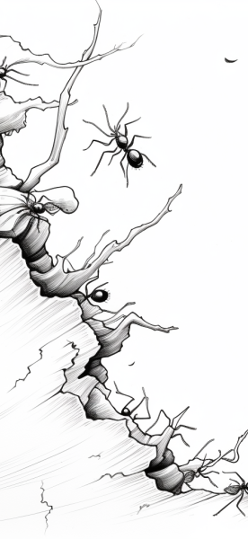
Project Scope and Features
Enhanced Crawling Efficiency
The multi-threaded architecture allows simultaneous data extraction from multiple web pages, significantly reducing the overall time required for large-scale web crawling tasks.
Robust URL Management
The integrated URL tracking system ensures that each URL is processed only once, preventing redundancy and allowing for efficient recovery from interruptions during the crawling process.
Customizable Crawl Depth
Users can define the depth of the crawl, enabling targeted data extraction and optimizing resource allocation based on specific information needs within a website's structure.

Slide 7
Core Technical Architecture

Slide 8




Components and Structure
ExecutorService Functionality
URL Tracker Efficiency
Modular Design Benefits
The URL Tracker's use of a HashSet ensures efficient memory usage and quick lookups, preventing duplicate URL processing and enabling seamless resumption of crawling after interruptions.
The modular architecture promotes separation of concerns, allowing individual components to be developed, tested, and maintained independently, which enhances overall system reliability and scalability.
The ExecutorService not only manages thread pools but also optimizes task execution by dynamically adjusting the number of active threads based on system load and resource availability.

Slide 9

Multi-Threading with ExecutorService
Thread Pool Management
The use of `ExecutorService` allows for efficient management of a thread pool, enabling the dynamic adjustment of active threads based on the workload, which optimizes resource utilization and enhances the performance of the web crawler by minimizing idle threads and maximizing throughput.

Slide 10

URL Tracking and Persistence Mechanisms
Concurrent URL Management
Implementing a `ConcurrentHashMap` for URL tracking enhances thread safety and performance, allowing multiple threads to efficiently check and update the status of URLs without risking data inconsistency or requiring extensive synchronization mechanisms.

Slide 11
Error Handling Strategies
01
02
03
Structured Exception Handling
Detailed Logging Mechanism
Adaptive Retry Mechanism
Utilize try-catch blocks within each thread to manage exceptions effectively, ensuring that network issues or malformed responses do not halt the entire crawling process, thus maintaining operational continuity.
Implement a comprehensive logging framework that captures error details, including timestamps and URLs, facilitating easier troubleshooting and performance analysis to identify recurring issues and improve system reliability.
Design a retry logic that intelligently attempts to fetch URLs after transient failures, incorporating exponential backoff strategies to enhance success rates while preventing excessive load on the server.

Slide 12
The Results and Future Directions

Slide 13

Crawling Speed Optimization
The multi-threaded web crawler achieves a remarkable reduction in crawling time, completing 1,000 URLs in under two minutes by utilizing ten concurrent threads, which demonstrates the effectiveness of parallel processing in enhancing throughput and minimizing latency in web data extraction tasks.
Performance Metrics and Analysis

Slide 14
References
“Jsoup: Java HTML Parser”, https://jsoup.org/
“ExecutorService Java Documentation”, https://docs.oracle.com/

Slide 15
Thank You

